Slide 1
E-R Diagram Mapping
Database System Concepts

Slide 2
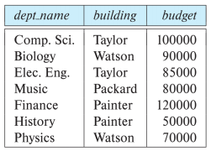
1. Logical Design
What is schema?
  The overall logical structure of the database, also called metadata
    Ex: department(dept_name, building, budget)
The department table

Slide 3
2. E-R Diagram Mapping
E-R Diagram Mapping Steps
  Step 1: Regular entity types and single valued attributes
  Step 2: Weak Entity Type and Single Value Attribute
  Step 3: Binary 1:1 Relationship Type
  Step 4: Regular binary 1:N relationship type
  Step 5: Binary M:N relationship type
  Step 6: Ternary or higher relationship types
  Step 7: Multi-valued attribute

Slide 4
2. E-R Diagram Mapping
Step 1: Regular entity types and single valued attributes
  One relation R is created for each regular entity type E
  Include all simple attributes in E in relation R
  For composite attributes, include all simple attributes of compound attributes from E to relation R
  E's key attribute becomes relation R's primary key

Slide 5
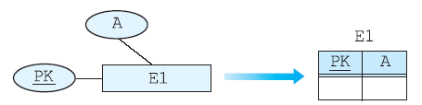
2. E-R Diagram Mapping
Step 1: Regular entity types and single valued attributes

Slide 6
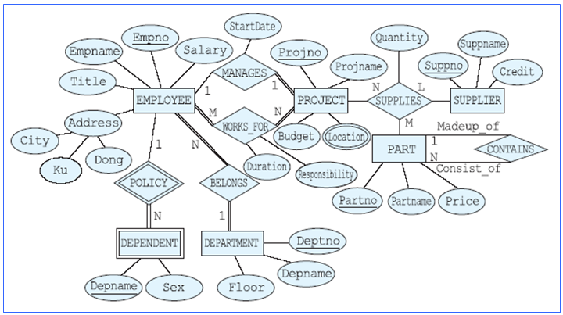
2. E-R Diagram Mapping
Step 1: Regular entity types and single valued attributes

Slide 7
2. E-R Diagram Mapping
Step 1: Regular entity types and single valued attributes
EMPLOYEE(Empno, Empname, Title, City, Ku, Dong,
Salary)
PROJECT(Projno, Projname, Budget)
DEPARTMENT(Deptno, Deptname, Floor)
SUPPLIER(Suppno, Suppname, Credit)
PART(Partno, Partname, Price)

Slide 8
2. E-R Diagram Mapping
Step 2: Weak Entity Type and Single Value Attribute
  Weak entity is dependent on strong entity
    Cannot exists without a corresponding strong entity
    Weak entity type does not have enough attributes to form a key
  Marked as Double Line Rectangle in ER Diagram
  Note that weak entity is connected to owner strong entity through Double Line Diamond

Slide 9
2. E-R Diagram Mapping
Step 2: Weak Entity Type and Single Value Attribute
  A relation W is created for each weak entity
  All simple attributes in a weak entity type is included in relation W
  The primary key of the relation corresponding to the owning entity type E is included as a foreign key in the relation W
  The primary key of relation W is a combination of a partial key of the weak entity type and a foreign key that refers to the relation corresponding to the owning entity type

Slide 10
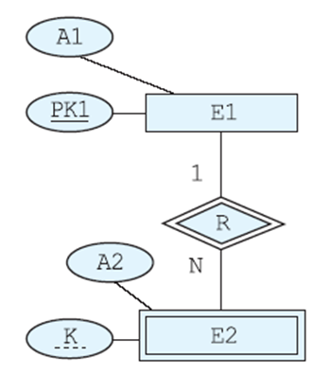
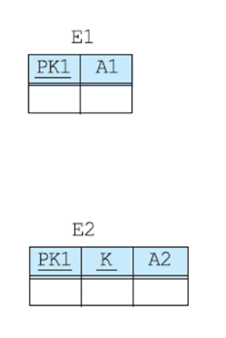
2. E-R Diagram Mapping
Step 2: Weak Entity Type and Single Value Attribute

Slide 11
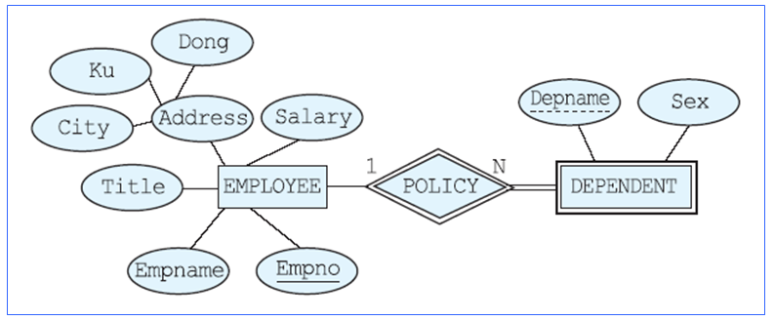
2. E-R Diagram Mapping
Step 2: Weak Entity Type and Single Value Attribute
DEPENDENT(Empno, Depname, Sex)

Slide 12
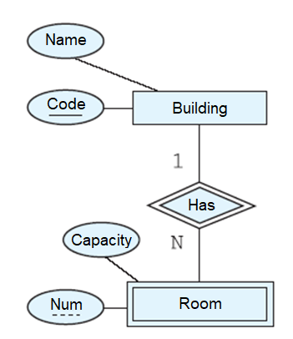
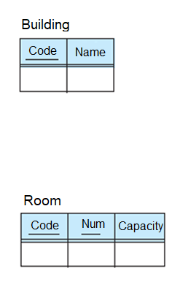
2. E-R Diagram Mapping
Step 2: Weak Entity Type and Single Value Attribute

Slide 13
2. E-R Diagram Mapping
Step 3: Binary 1:1 Relationship Type
  For each binary 1:1 relationship type R in the ER schema, the relations S and T corresponding to the entity types participating in R are found
  Select one relation between S and T, and if S is selected, the primary key of T is included in S as a foreign key
  All simple attributes of the relationship type R (if they have a compound attribute, the simple attributes constituting the compound attribute) are included in the relation corresponding to S
  Among S and T, the relation that fully participates in the relationship type is selected as the relation that plays the role of S

Slide 14
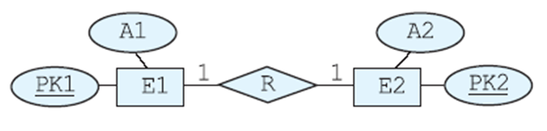
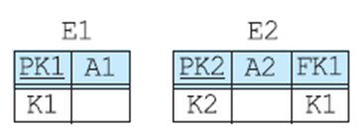
2. E-R Diagram Mapping
Step 3: Binary 1:1 Relationship Type

Slide 15
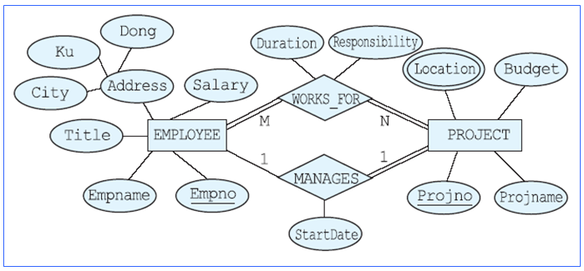
2. E-R Diagram Mapping
Step 3: Binary 1:1 Relationship Type
PROJECT(Projno, Projname, Budget, Manager, MStartDate)

Slide 16
2. E-R Diagram Mapping
Step 4: Regular binary 1:N relationship type
  For the regular binary 1:N relationship type R, find the relation S corresponding to the participating entity type on the N side
  The primary key of relation T is included in relation S as a foreign key
  All simple attributes of the relation type R (if they have a compound attribute, the simple attributes that make up the compound attribute) are included in the relation corresponding to S

Slide 17
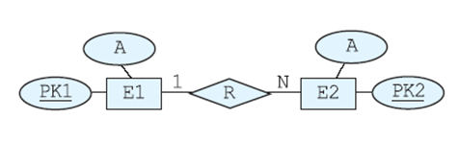
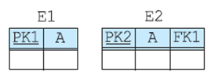
2. E-R Diagram Mapping
Step 4: Regular binary 1:N relationship type

Slide 18
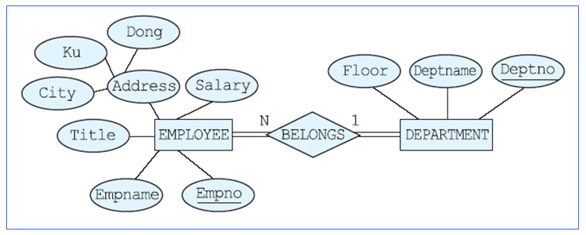
2. E-R Diagram Mapping
Step 4: Regular binary 1:N relationship type
EMPLOYEE(Empno, Empname, Title, City, Ku, Dong, Salary, Dno)

Slide 19
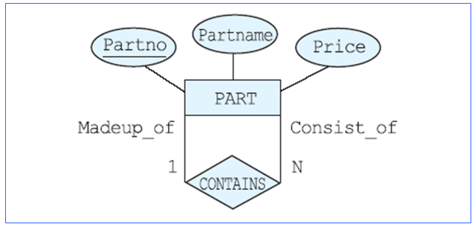
2. E-R Diagram Mapping
Step 4: Regular binary 1:N relationship type
PART(Partno, Partname, Price, Subpartno)

Slide 20
2. E-R Diagram Mapping
Step 5: Binary M:N relationship type
  For binary M:N relationship type R, create relation R
  Primary keys of relations corresponding to the participating entity type are included in relation R as foreign keys, and a combination of these becomes the primary key of relation R
  All simple attributes of the relationship type R (if they have a compound attribute, the simple attributes that make up the compound attribute) are included in relation R
  If primary keys of relations corresponding to the participating entity type cannot uniquely identify the rows, then a combination of keys, including simple attributes of relation R, are used to form the primary key

Slide 21
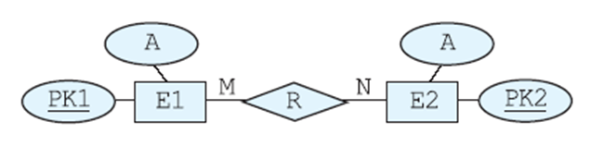
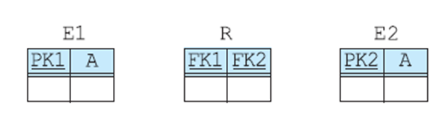
2. E-R Diagram Mapping
Step 5: Binary M:N relationship type

Slide 22
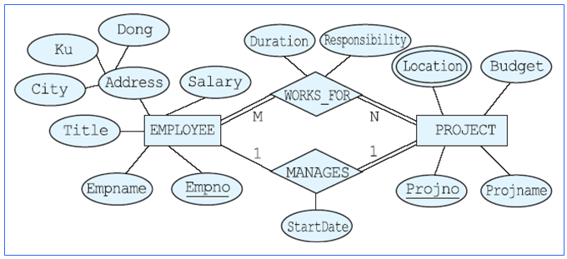
2. E-R Diagram Mapping
Step 5: Binary M:N relationship type
WORKS_FOR(Empno, Projno, Duration, Responsibility)

Slide 23
2. E-R Diagram Mapping
Step 6: Ternary or higher relationship types
  Relation R is created for each relation type R of ternary
  Include primary keys of relations corresponding to all entity types participating in relation type R as foreign keys in relation R
  All simple attributes of the relation type R (if they have a compound attribute, the simple attributes that make up the compound attribute) are included in relation R

Slide 24
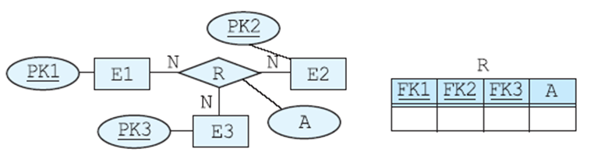
2. E-R Diagram Mapping
Step 6: Ternary or higher relationship types
  In general, a combination of foreign keys becomes the primary key of relation R

Slide 25
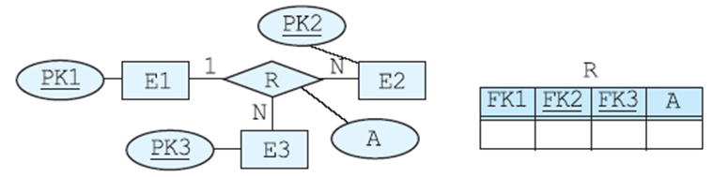
2. E-R Diagram Mapping
Step 6: Ternary or higher relationship types
  If the cardinality of the entity types participating in the relationship type R is 1:N:N, the combination of the remaining foreign keys except for the foreign key referring to the primary key of the relation with cardinality of 1 becomes the primary key of relation R

Slide 26
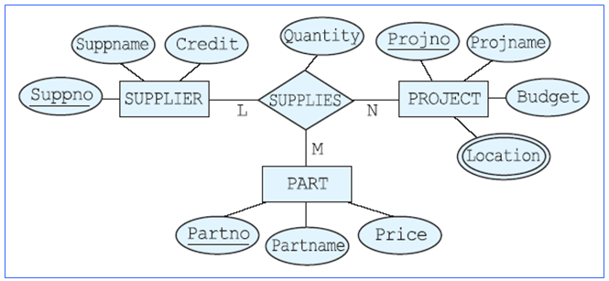
2. E-R Diagram Mapping
Step 6: Ternary or higher relationship types
SUPPLY(Suppno, Projno, Partno, Quantity)

Slide 27
2. E-R Diagram Mapping
Step 7: Multi-valued attribute
  Create a relation R for each multivalued attribute
  Include the attribute corresponding to the multi-valued attribute in relation R
  Include the primary key of the relation corresponding to the entity type or relation type having the multi-valued attribute as an attribute in relation R as a foreign key
  The primary key of R in the relation is a combination of a multi-valued attribute and a foreign key

Slide 28
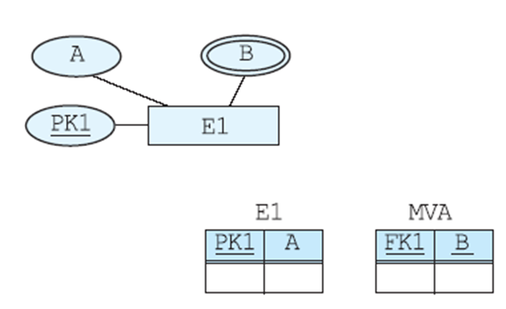
2. E-R Diagram Mapping
Step 7: Multi-valued attribute

Slide 29
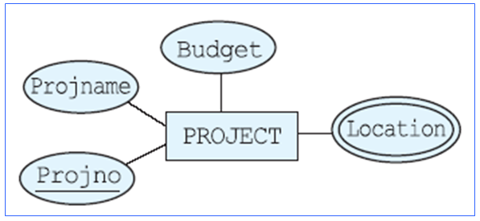
2. E-R Diagram Mapping
Step 7: Multi-valued attribute
PROJ_LOC(Projno, Location)

Slide 30
2. E-R Diagram Mapping
Applying the algorithm to the database design case
Step 1: Regular entity types and single valued attributes
EMPLOYEE(Empno, Empname, Title, City, Ku, Dong,
Salary)
PROJECT(Projno, Projname, Budget)
DEPARTMENT(Deptno, Deptname, Floor)
SUPPLIER(Suppno, Suppname, Credit)
PART(Partno, Partname, Price)

Slide 31
2. E-R Diagram Mapping
Applying the algorithm to the database design case
Step 2: Weak Entity Type and Single Value Attribute
DEPENDENT(Empno, Depname, Sex)
Step 3: Binary 1:1 Relationship Type
PROJECT(Projno, Projname, Budget, Manager, MStartDate)
Step 4: Regular binary 1:N relationship type
EMPLOYEE(Empno, Empname, Title, City, Ku, Dong, Salary, Dno)
PART(Partno, Partname, Price, Subpartno)

Slide 32
2. E-R Diagram Mapping
Applying the algorithm to the database design case
Step 5: Binary M:N relationship type
WORKS_FOR(Empno, Projno, Duration, Responsibility)
Step 6: Ternary or higher relationship types
SUPPLY(Suppno, Projno, Partno, Quantity)
Step 7: Multi-valued Attribute
PROJ_LOC(Projno, Location)

Slide 33
2. E-R Diagram Mapping
The company ER schema was mapped into a total of 9 relations in the relational database
EMPLOYEE(Empno, Empname, Title, City, Ku, Dong, Salary, Dno)
PROJECT(Projno, Projname, Budget, Manager, MStartDate)
DEPARTMENT(Deptno, Deptname, Floor)
SUPPLIER(Suppno, Suppname, Credit)
PART(Partno, Partname, Price, Subpartno)
DEPENDENT(Empno, Depname, Sex)
WORKS_FOR(Empno, Projno, Duration, Responsibility)
SUPPLY(Suppno, Projno, Partno, Quantity)
PROJ_LOC(Projno, Location)

Slide 34
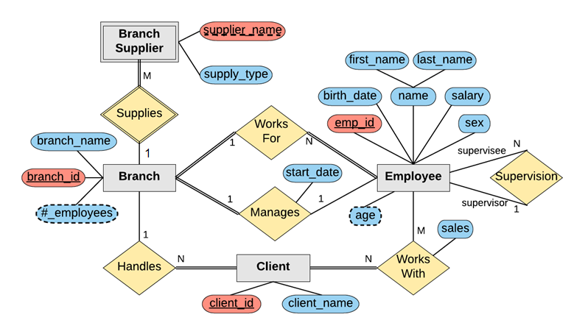
3. Exercise
Given the following ER Diagram, map it into logical schemas

Slide 35
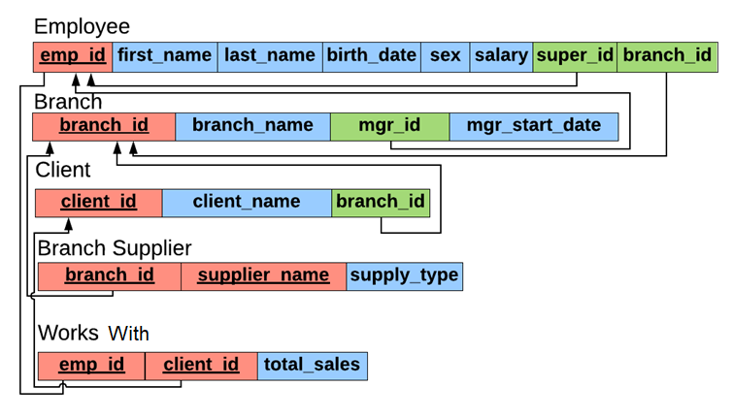
3. Exercise
Result of mapping

Slide 36
4. Summary and Discussions
E-R Diagram Mapping Steps
  Step 1: Regular entity types and single valued attributes
  Step 2: Weak Entity Type and Single Value Attribute
  Step 3: Binary 1:1 Relationship Type
  Step 4: Regular binary 1:N relationship type
  Step 5: Binary M:N relationship type
  Step 6: Ternary or higher relationship types
  Step 7: Multi-valued attribute

